Slide 1
QUALITY ANALYST
Presenter : Drisha.J

Slide 2
TOPICS OVERVIEW
PRIMARY TOPICS:
Testing fundamentals (unit, integration,
E2E)
Automation tools: Playwright, Cypress,
Selenium basics
API testing: Postman collections & Newman
automation
React testing: Jest + React Testing Library
CI/CD integration for testing
SECONDARY TOPICS:
REST API concepts
JWT & OAuth2
Web component testing
Performance testing: JMeter/k6
Cloud basics for QA

Slide 3
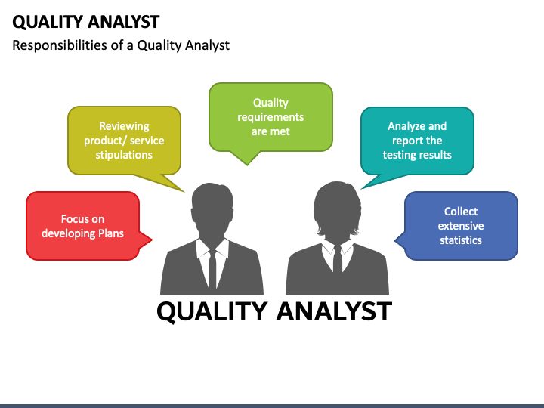
QUALITY ANALYST
WHO IS A QUALITY ANALYST?
A Quality Analyst (QA) is a professional responsible for ensuring that the final product meets business requirements, user expectations, and technical quality standards before it is released.
They act as a bridge between development and end-users, ensuring every feature is tested, bugs are fixed, and the system performs smoothly.
Example Scenario:
In an e-commerce project, a QA will:
Check that login and payment features work correctly.
Ensure product data loads accurately through APIs.
Run automated UI tests for add-to-cart flow.
Ensure all automated tests pass before deployment.

Slide 4
What Does a Quality Analyst Do?
1.Understand Requirements
  Analyze project goals and business needs.
  Identify what needs to be tested and define quality benchmarks.
2.Create Test Plans & Cases
  Design manual and automated tests for various scenarios.
  Document expected results and conditions for acceptance.
3.Execute Tests
  Perform Unit, Integration, and End-to-End (E2E) testing.
  Validate both functional and non-functional aspects (like performance, usability, security).
4.dentify & Report Bugs
  Track issues using tools like JIRA.
  Collaborate with developers to fix and re-test defects.
5.Automate Testing Processes
  Use tools like Selenium, Cypress, or Playwright to reduce manual effort.
  Ensure regression testing is automated for faster releases.
6.API & UI Validation
  Test APIs using Postman and automate them with Newman.
  Validate front-end behavior with Jest and React Testing Library.
7.Integrate Testing in CI/CD
  Ensure automated tests run during every code deployment (using Jenkins, GitHub Actions, etc.).
  Maintain continuous feedback on software quality.

Slide 5
TESTING FUNDAMENTALS
What is Software Testing?
Software Testing ensures that software meets business and technical requirements, works correctly, and provides a great user experience.
Types of Testing Levels:
Unit Testing – Tests individual components or functions in isolation.
Example: Checking a login function returns “Success” for valid input.
Integration Testing – Verifies communication between multiple modules work smoothly together.
Example: Testing whether “Order” and “Payment” modules work together.
End-to-End (E2E) Testing – Validates the entire application flow from start to finish.
Example: User logs in -> adds item -> makes payment -> order confirmation.
QA Role:
Ensure coverage of all test levels.
Validate business workflows through E2E testing.
Collaborate with dev team to identify issues early.

Slide 6
AUTOMATION TOOLS
What is Automation?
Automation reduces manual effort, increases test coverage, and ensures consistent testing across builds.
Popular Tools:
1.Selenium – Open-source framework for web UI testing .It is an older tool but works with many languages like python and java.
  Supports multiple browsers and languages.
  Example: Automate login page validation.
2.Cypress – Modern JavaScript framework for fast, reliable browser testing.
  Example: Verify checkout flow in an e-commerce site.
3.Playwright – Developed by Microsoft; supports cross-browser and mobile testing and full system testing.
  Example: Test both Chrome and Safari views of a React app.
QA Role:
Select right tools based on project needs.
Maintain reusable automated test scripts.
Integrate automation into CI/CD pipelines.

Slide 7
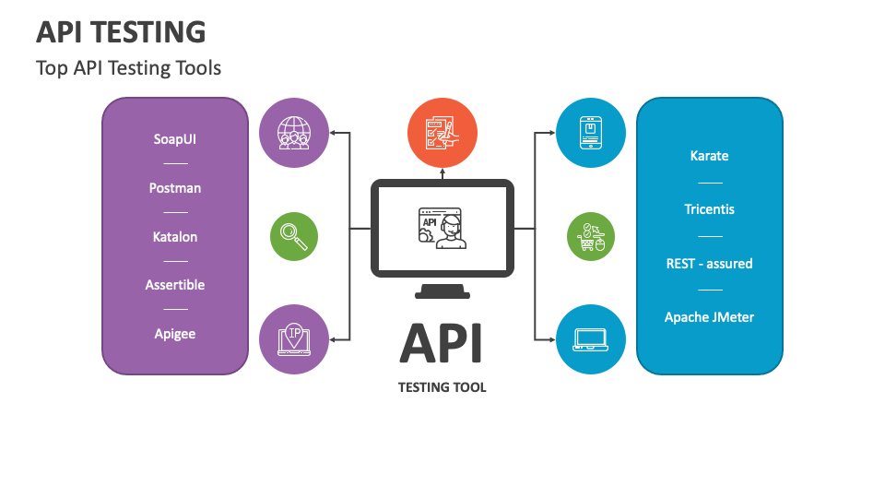
API TESTING
Purpose of API Testing :
To ensure APIs function as expected, return correct data, and handle errors properly.
It test the request and response between applications
Using Postman:
Send requests (GET, POST, PUT, DELETE) and validate responses.
Check status codes, response time, and data accuracy.
Example: Verify “Add to Cart” API returns correct total price.
Newman Automation:
CLI tool to run Postman collections automatically.
Used in CI/CD to execute API tests after each build.
QA Role:
Create and maintain Postman collections.
Write assertions for response validation.
Integrate Newman in Jenkins/GitHub Actions for automation.

Slide 8
Purpose of API Testing :
To ensure APIs function as expected, return correct data, and handle errors properly.
It test the request and response between applications
Using Postman:
Send requests (GET, POST, PUT, DELETE) and validate responses.
Check status codes, response time, and data accuracy.
Example: Verify “Add to Cart” API returns correct total price.
Example
Let’s test an API endpoint:
GET → https://reqres.in/api/users?page=2
Steps:
Open Postman
Create a new request
Choose GET and enter URL:
https://reqres.in/api/users?page=2
Click Send
You’ll get a response with response data in JSON format
Newman Automation:
CLI tool to run Postman collections automatically.
Used in CI/CD to execute API tests after each build.
QA Role:
Create and maintain Postman collections.
Write assertions for response validation.
Integrate Newman in Jenkins/GitHub Actions for automation.
Example
Step 1: Export your Postman collection: e.gMyCollection.json
Step 2: Run it using Newman from your terminal .
Newman runs MyCollection.json
Run all the API requests in that collection.
Shows the test results (Pass/Fail) in your terminal.
Example Output:
GET https://reqres.in/api/users?page=2
Status code: 200 OK

Slide 9
REACT TESTING
Purpose:
To check if React components display the right content and behave correctly when users interact with them (like clicking, typing, or submitting).
Jest:
A JavaScript testing framework used for unit testing React code.
It helps test if components render properly and return correct outputs.
Example: Check if a “Login” button shows the correct text and calls the login function when clicked.
React Testing Library (RTL):
Used for testing user interactions instead of internal code logic.
Focuses on how the app behaves from a real user’s point of view.
Example : Simulate typing an email and password in a login form and check if the “Welcome” message appears after clicking Submit.
QA Role:
Write simple and meaningful test cases for React components.
Make sure the user interface behaves as expected.
Work closely with developers to fix issues found during testing.

Slide 10
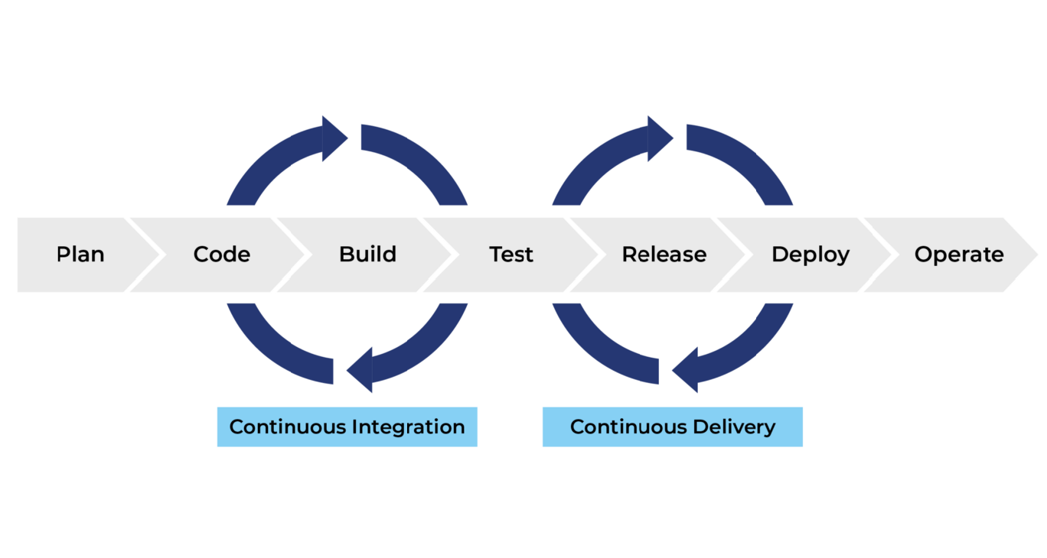
CI/CD INTEGRATION FOR TESTING
Definition:
CI/CD (Continuous Integration / Continuous Deployment) automates the process of building, testing, and deploying software so that every change in code is checked automatically.
How It Works:
Developer updates the code in GitHub or Jenkins.
The CI/CD pipeline automatically runs tests (unit, API, and UI).
If all tests pass → the code is deployed to the next environment (like staging or production).
Tools Used:
Jenkins, GitHub Actions, GitLab CI.
Example: When a developer uploads new code,
Jenkins automatically runs Jest tests for React components,
Newman runs API tests,
If everything passes, the new version of the app is deployed.
QA Role:
Set up and maintain automated tests in the CI/CD pipeline.
Monitor test reports and ensure all tests pass.
Report failed builds and coordinate with developers to fix issues.

Slide 11
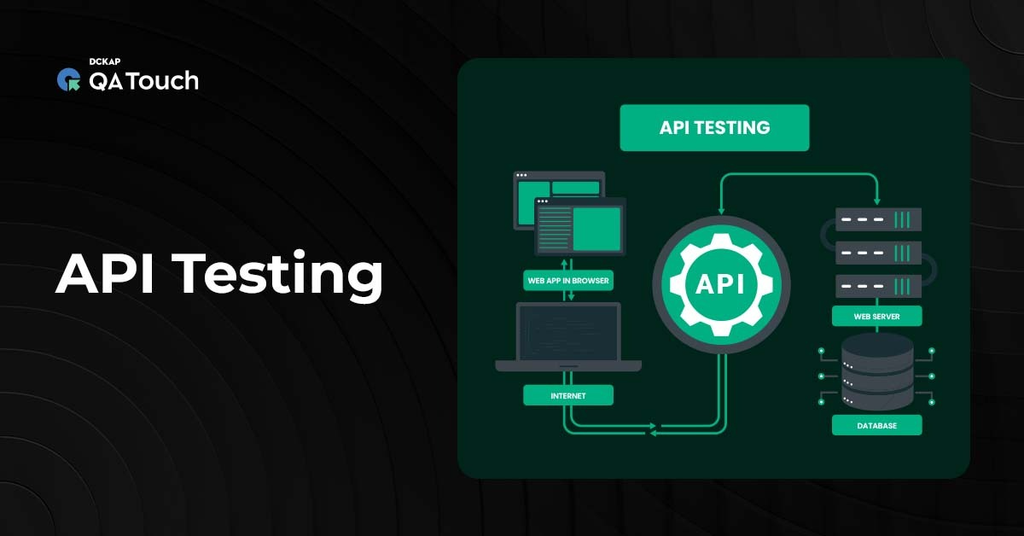
REST API BASICS
What is REST APIs?
REST (Representational State Transfer) APIs allow communication between systems over HTTP.
It’s a standard way to send and receive data between a client (e.g., browser, mobile app) and server.
Key Concepts:
Request: Client sends data or asks for information (GET, POST, PUT, DELETE).
Response: Server sends back the requested data along with a status code(200 OK, 404 Not Found).
Example:
1.Request: GET /sales-data?month=September
2.Response: JSON containing sales figures for September.
Sql:GET https://api.company.com/sales?month=September
Json body:
{
"month": "September",
"total_sales": 150000,
"region": "North"
}

Slide 12
Request–Response Flows
Why It’s Important for QA
What is a Request-Response Flow?
It’s the communication process between a client and a server in a web or API system.
When you access a web page, or connect to a data API - a request is sent, and a response is received.
This mechanism ensures data exchange between application.
Example:
When you click “Login”,
→ A POST request goes to the server with your username & password.
→ The server sends a response (success or error message).
Reason | Why It Matters | Example
1. Understand app behavior | QA can know how frontend & backend communicate. | Login request -> server returns token -> user logged in.
2. Find bugs easily | Helps detect if an issue is from frontend or backend. | Login fails - QA checks response: is it 400 Bad Request or 500 Server Error?
3. Validate data correctness | Ensures data sent/received is correct and secure. | Check if API returns correct user details after login.
4. Test performance & security | Verify response time and proper error messages. | Response takes too long -> report as performance issue.
5. API Testing | Most QA API tests depend on understanding requests & responses. | In Postman, QA validates status code (200, 404, 500) and response body.

Slide 13
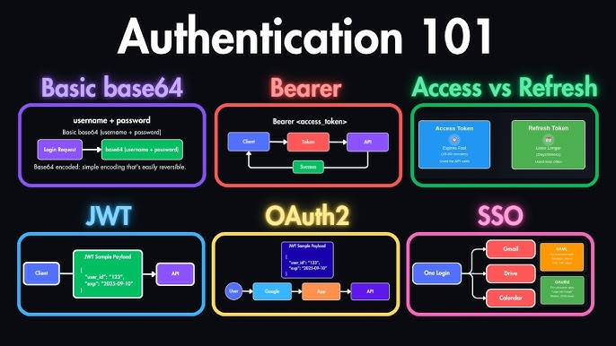
Authentication: JWT & OAuth2
WHAT IS MEANT BY AUTHENTICATION?
Authentication means verifying who the user is.
It checks whether the person trying to access a system is really who they say they are.
Example:
When you log in to your Gmail account:
You enter your email (username) and password.
Gmail checks in its database — if your credentials match.
If correct → You are authenticated (allowed in).
If wrong → Access is denied.
As a QA, you should check:
Login works only with correct credentials.
Invalid users cannot access the system.
Tokens (like JWT) are properly verified and expire after a certain time.
Secure login methods (like OAuth2, 2FA) work properly.

Slide 14
JSON WEB TOKENS(JWT)
JWT(Json Web Tokens):
JWT is a compact, encoded token used for securely transmitting information between two parties usually the client (user) and the server.
It helps the server identify who is making the request without needing to check the database every time.
Structure:
A JWT has 3 parts, separated by dots (.):
Header -> contains algorithm and token type
Payload -> contains user data (like userId, email, etc.)
Signature -> verifies the token is valid and not tampered with.
Example:
OiJIUzI1NiIsInR5cCI6IkpXVCJ9.eyJ1c2VySWQiOjEsIm5hbWUiOiJKYW5lIn0
How it works:
User logs in with valid credentials.
Server generates a JWT and gives it to the client.
Client sends this token with each new API request.
Server verifies token -> if valid, access is granted.
QA Validates:
Token is generated correctly after login.
Token expires at the expected time.
Invalid/expired tokens are rejected by the API.
No access is allowed without a valid token.

Slide 15
OAuth2
What is meant by OAuth2?
OAuth2 is an authorization framework used when you log in via Google, GitHub, Facebook, etc.
It allows third-party apps to access user data without sharing passwords -instead, it uses access tokens.
It helps apps access limited user data securely like name or email using tokens instead of passwords.
Example:
When you choose “Sign in with Google,” OAuth2 handles the process of verifying your identity securely.
GET https://www.googleapis.com/userinfo/v2/me
Authorization: Bearer ya29.a0AfH6SMB...
Tokens Used:
1.Access Token: Used to access resources for a short time.
2.Refresh Token: Used to get a new access token when the old one expires.
How it works (Real-Time Flow):
You click “Continue with Google”
-Canva redirects you to Google’s login page.
You log in with your Google account
- Google asks: “Allow Canva to access your name and email?”
You click Allow
-Google sends an Access Token to Canva.
Canva uses that token
Canva now gets your basic info (like name, profile picture) from Google without knowing your password.
You are logged into Canva safely using Google!
QA Tests:
As a QA, you should check:
Redirect to Google works correctly.
Permission popup appears properly.
Token is received and used correctly.
Access is blocked when token expires or is invalid.

Slide 16
Web Component Testing
What are Web Components?
They are reusable UI parts like buttons, forms, modals built using HTML, CSS, and JavaScript.
They make web development modular and consistent.
QA Focus Areas:
Check each component’s functionality (click, hover, input).
Verify appearance and responsiveness across devices.
Ensure integration between components works in browsers.
Common Tools:
Playwright / Cypress -> For functional & UI behavior testing.
Storybook + Jest -> For visual regression & component unit testing.
Real-Time Example:
If you’re testing a login page:
Check if the “Login” button gets disabled until fields are filled
After clicking, verify the loader and redirect to the dashboard
QA ensures:
The text, color, and size of the button are correct
Button responds properly to clicks
The message or next action appears after clicking
Component works on different browsers and screen sizes

Slide 17
Performance Testing
What is Performance Testing?
Performance testing checks how fast and stable an app is under different loads.
Goal: Identify performance issues before release.
Example:
If 1,000 people use a shopping website during a sale, QA ensures the site doesn’t slow down or crash.
What QA Checks
Response time (how fast pages load)
Errors or crashes under load
CPU and memory usage
Report bottlenecks or performance issues
Tools Used
JMeter – GUI tool to simulate users and see performance graphs
k6 – Code-based tool to test APIs and integrate with CI/CD
LoadRunner – Enterprise tool for performance testing
Type | Purpose | Simple Example
1.Load Testing | Check if app works fine under expected (normal) load. | 500 users shopping on a website — does it stay fast?
2.Stress Testing | Push system beyond its limit to find breaking point. | 5,000 users login at once — does it crash or slow down?
3.Spike Testing | Test sudden traffic increase. | Suddenly 2,000 users open site after a sale starts.
4.Endurance (Soak) Testing | Check long-term stability. | 200 users use app continuously for 24 hours — does it leak memory or slow down?

Slide 18
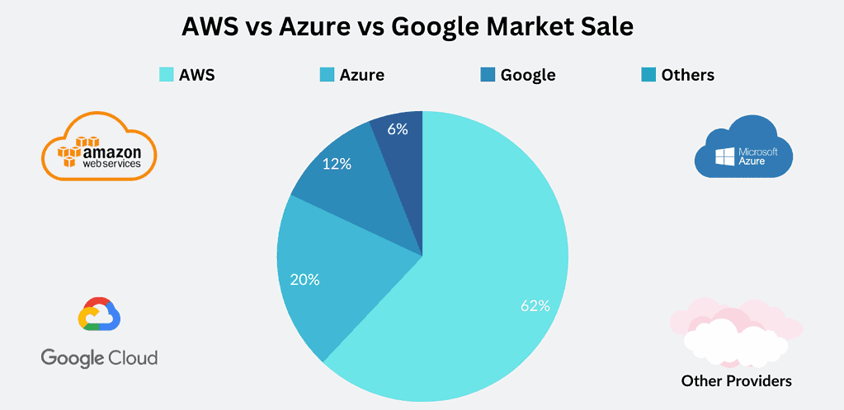
Cloud Basics for QA
Why Cloud Matters:
Modern apps run on cloud platforms like AWS, Azure, and GCP. QA ensures testing works properly in these environments.
QA Responsibilities:
Scalability: App handles more users without issues.
Availability: App stays up even if some servers fail.
Data Security: Only authorized users can access data.
Example: QA runs Playwright or API tests on AWS or Azure pipelines to verify all endpoints work properly after deployment.

Slide 19
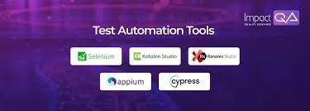
Tools & Platforms QA Should Know
Cloud Platforms: AWS, Azure, Google Cloud (GCP)
Testing Tools:
  Playwright / Cypress -> Web testing in cloud environments
  Postman / Newman ->API testing
  JMeter / k6 -> Performance testing
CI/CD Pipelines: Run automated tests in cloud (e.g: GitHub Actions, Jenkins, Azure DevOps)
Real-Time Example
A banking web app is hosted on AWS.
QA runs Playwright tests in the cloud to verify:
  Login and transactions work
  Performance is stable under high load
  Data remains secure and encrypted

Slide 20
THANK YOU
Presented By:Drisha.J

